Slide 1
Unsupervised Learning
Aditya Devarakonda
1/14/20

Slide 2
Categories of Machine Learning Problems
Supervised Learning
The data has labels, so you know when prediction is wrong.

Slide 3
Categories of Machine Learning Problems
Supervised Learning
The data has labels, so you know when prediction is wrong.

Slide 4
Categories of Machine Learning Problems
Supervised Learning
Data: (image of cat, label for cat)
Goal: Learn mapping from image of cat → label for cat.

Slide 5
Categories of Machine Learning Problems
Supervised Learning
Data: (image of cat, label for cat)
Goal: Learn mapping from image of cat → label for cat.
Unsupervised Learning
Data: (image of cat). No label!
Goal: ???

Slide 6
Categories of Machine Learning Problems
Supervised Learning
Data: (image of cat, label for cat)
Goal: Learn mapping from image of cat → label for cat.
Unsupervised Learning
Data: (image of cat). No label!
Goal: Learn similarities/differences between images. Learn to generate similar images.

Slide 7
Unsupervised Learning
Learning underlying structure of data.
Generate similar data.
Reduce dimensionality of data.
Generates labels on the fly without human input.

Slide 8
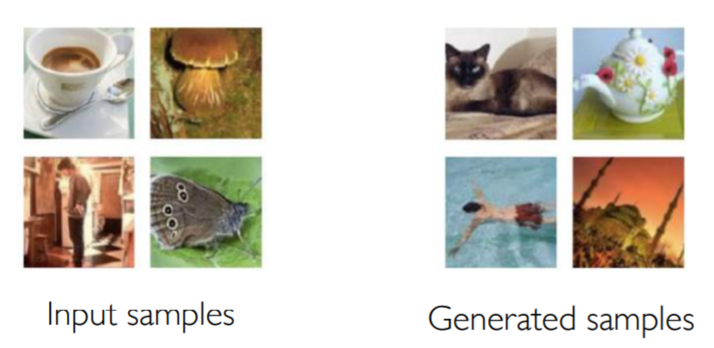
Generative Modeling
Goal: Take input data and try to understand the structure of the data.
Sample Generation
Given some input, generate similar output

Slide 9
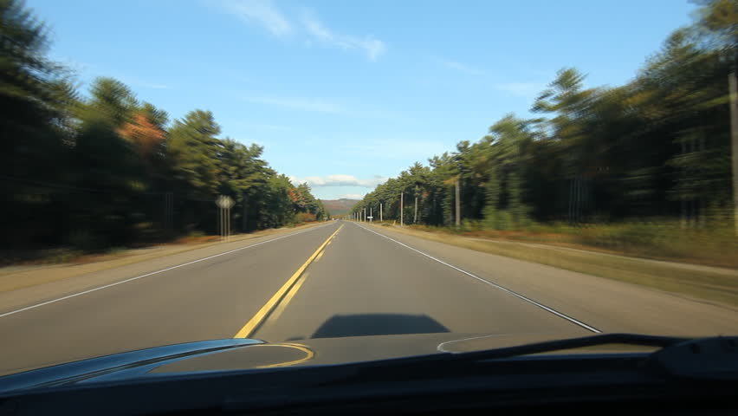
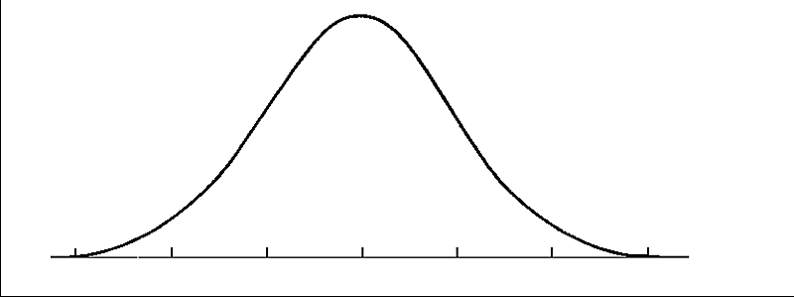
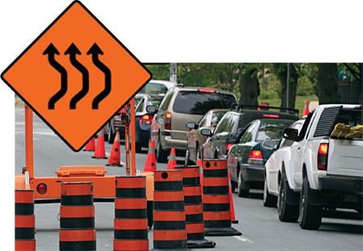
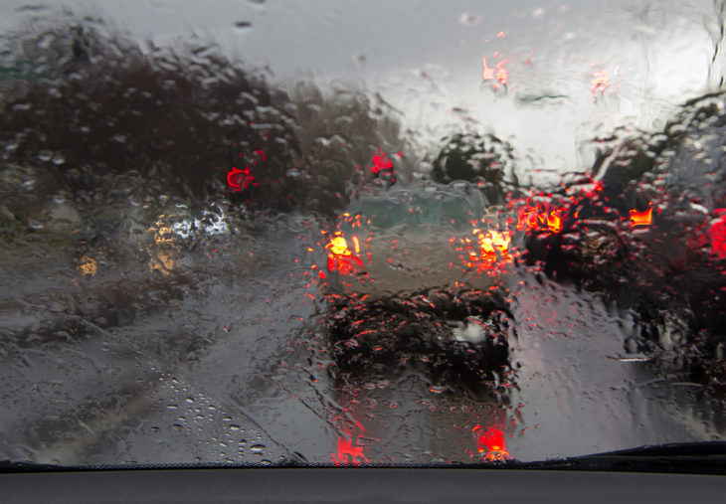
Generative Modeling
Use generative models to detect outlier events.
Improve self-driving cars with generative models!
A large portion of driving
Bad Weather
Lane Shift
Outliers

Slide 10
Generative Modeling: Examples
Real data
Autoencoder
Generative
Adversaial
Networks (GANs)
Same dimensions
Fake data
How do autoencoders work?

Slide 11






Autoencoders
Why should we care about $z$?
$$z$$

Slide 12
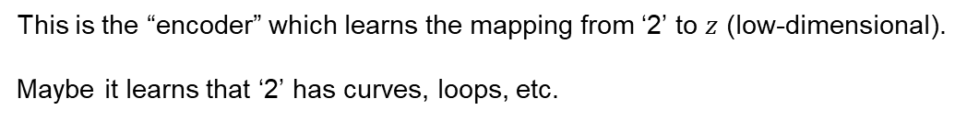

Autoencoders
Why should we care about $z$?
$$x$$
$$z$$
This is the “encoder” which learns the mapping from ‘2’ to $z$ (low-dimensional).
Maybe it learns that ‘2’ has curves, loops, etc.

Slide 13
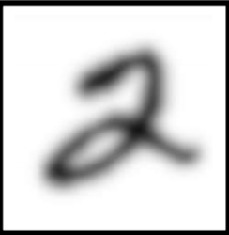




Autoencoders
Reconstruction of the original data.
This is the “decoder” takes $z$ (low-dimensional)
and learns mapping to the output $x′$.
$$x$$
$$x′$$
$$z$$

Slide 14
Autoencoders
$$x$$
$$x′$$
$$z$$
No labels needed.

Slide 15

Generative Adversarial Networks (GANs)
What if we want to generate fake data?
Deep Fakes!
$$z$$
Generator
Fake data

Slide 16
Generative Adversarial Networks (GANs)
Solution: Start from random numbers and make Generator learn the mapping from noise to fake data.
$$z$$
Generator
Fake data

Slide 17

Generative Adversarial Networks (GANs)
Real data
Discriminator tries to figure out which data is real.
Discriminator teaches Generator how to produce realistic images.
Fake data
$$z$$
Generator
Discriminator
$$y$$

Slide 18
GANs intuition
Generator stats from random noise.
Generator
Fake data

Slide 19
GANs intuition
Generator starts from random noise.
Discriminator
Generator
Fake data

Slide 20
GANs intuition
Discriminator tries to identify real data.
Discriminator
Generator
Real data
Fake data
Bars = initial probabilities of being real.

Slide 21
GANs intuition
Generator starts from random noise.
Discriminator
Generator
Real data
Fake data

Slide 22
GANs intuition
Discriminator correctly identifies real data.
Discriminator
Generator
Real data

Slide 23
GANs intuition
Generator tries to improve fake data.
Discriminator
Generator
Real data

Slide 24
GANs intuition
Training goes back and forth until:
Generator approximates true data well.
Discriminator cannot tell them apart.
Generator
Discriminator

Slide 25
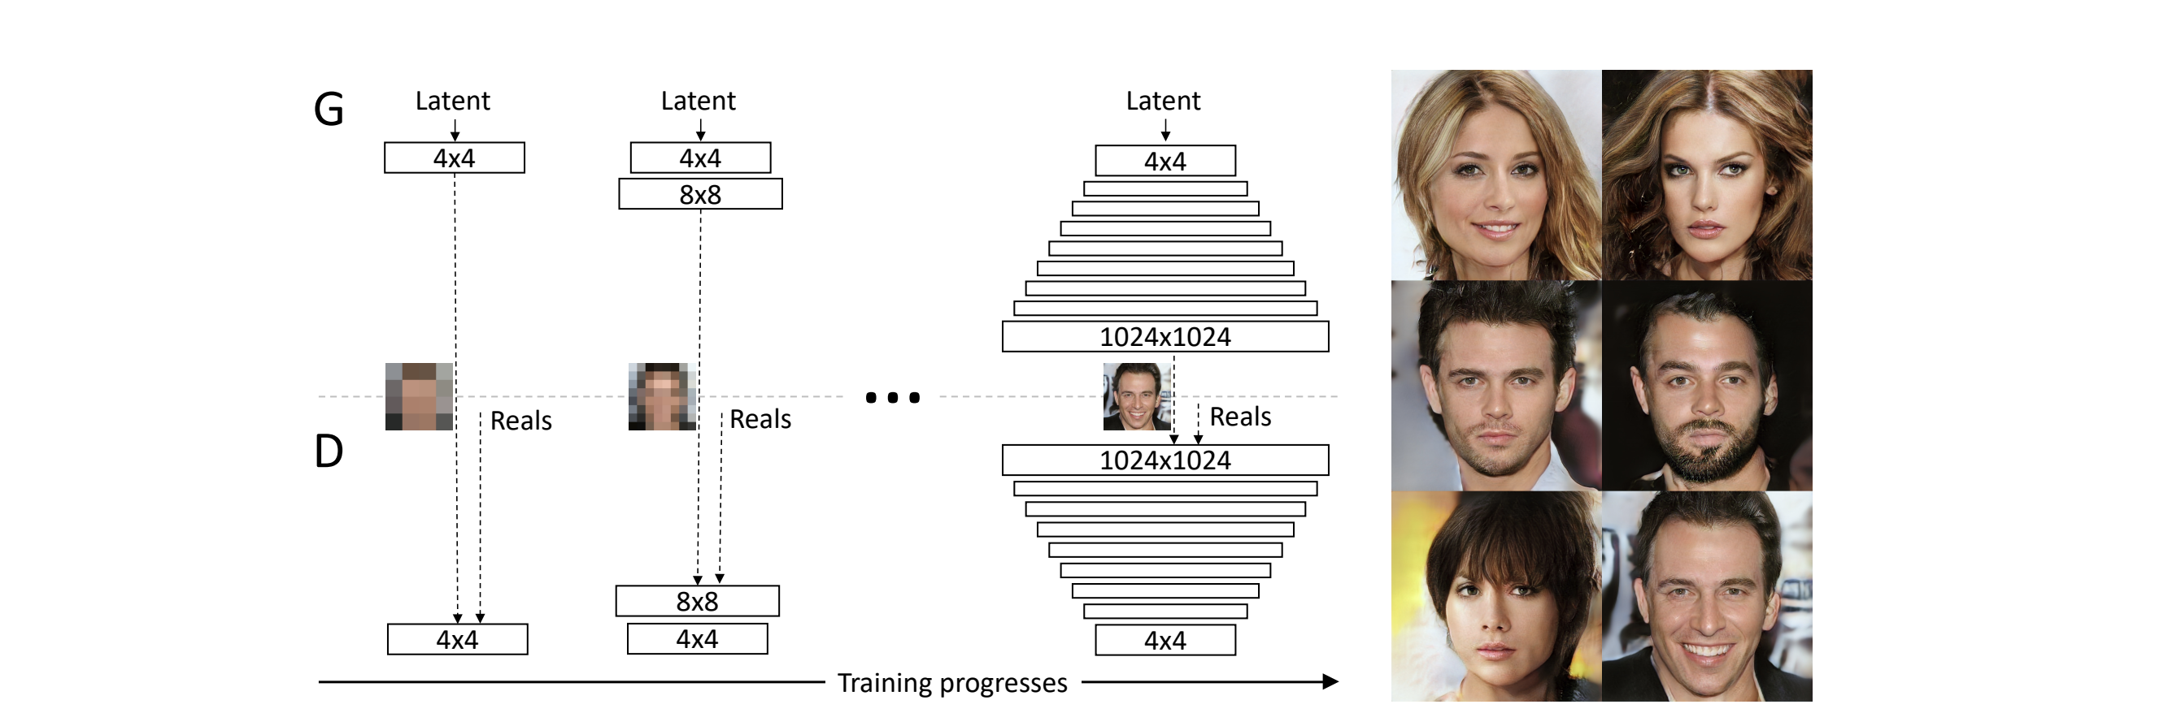
Progressively Growing GANs

Slide 26
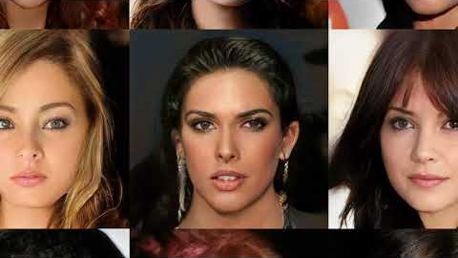
Progressively Growing GANs: Results
Notes:
Deep fakes example.

Slide 27
Categories of Machine Learning Problems
Unsupervised Learning Reinforcement Learning
Data: (image of cat) Data: state-action pairs.
No labels
Goal: Learning underlying structure. Goal: Maximize future reward.

Slide 28
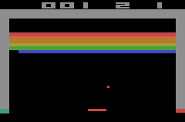
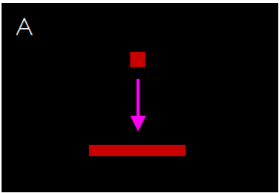
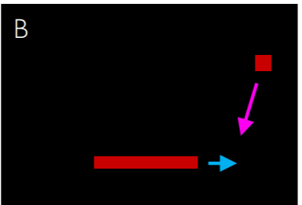

Value Learning
Which $(s,a)$ pair has higher $Q$ value?

Slide 29
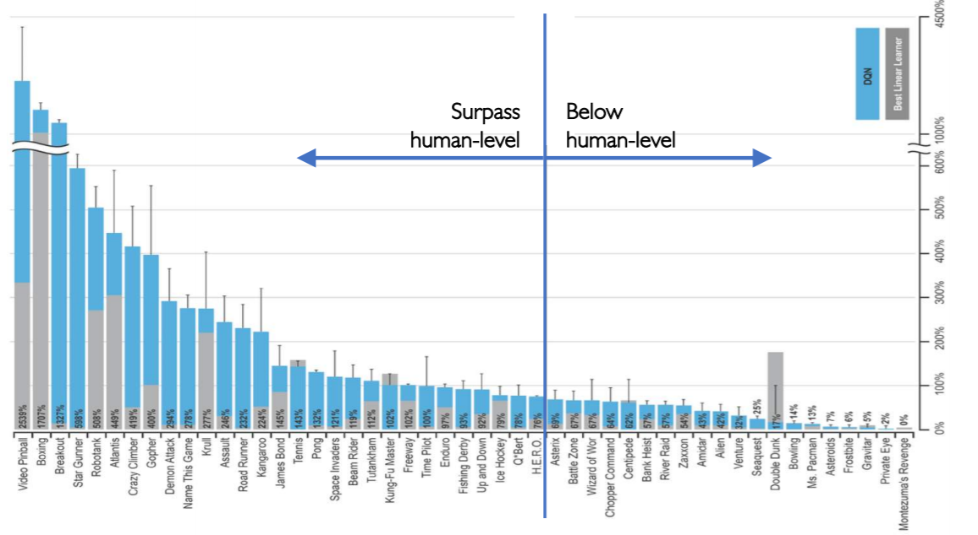
Atari DQN Results

Slide 30
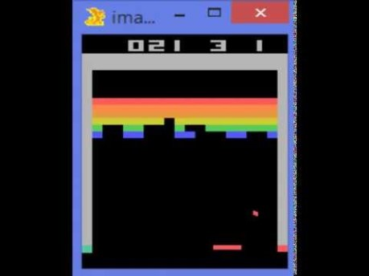
Reinforcement Learning with Atari Breakout

Slide 31
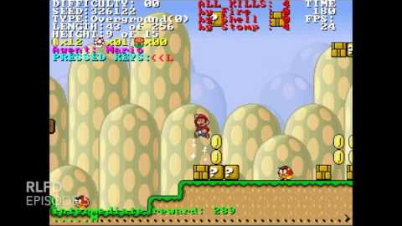
Reinforcement Learning with Super Mario

Slide 32
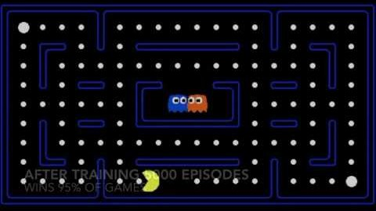
Reinforcement Learning with Pac-Man

